Slide 1


Understanding
the energy access
skills landscape
16 May 2022

Slide 2



Report structure
In compiling this report, and the accompanying stakeholder map, we conducted interviews and focus groups, with a range of stakeholders with diverse perspective on the energy access skills space. We also drew on a few of the most relevant publications in recent years (see slide 4).The aim of these conversations was to understand:
Sources of information
The significance of addressing the energy access skills gap to achieving global energy access and climate targets, as well as decent jobs and livelihoods.
The challenges to addressing the skills gap and the approaches and solutions that can support this, at scale. These have been categorised into seven areas.
Finally, we provide recommendations for the role of grant funding, specifically, in catalysing skills development at scale.
  We have also provided a database of work already happening in different geographies that can be scaled and replicated (see accompanying sector map in Excel).

Slide 3
Interviews:
Sources of information
Focus Group 1
FG1-TH - Futurepump – Toby Hammond
FG1-DK - Solar Freeze – Dysmus Kisilu
FG1-CC - Oorja Solutions – Clementine Chambon
FG1-SK - BVT – Sudhir Kulkarni
FG1-PJ - Onergy – Piyush Jaju
LL – Lais Lona, Power Africa
IR – Divyam Nagpal & Samah ElSayed, IRENA
RS – Rebekah Shirley, WRI
JMK – Jane Muigai Kamphuis, Toolkit iSkills
CM – Chiedza Mazaiwana, EEP Africa
HJ – Huda Jaffer, SELCO Foundation
AJ – Abhishek Jain, CEEW
DLG – Diane Le Goff, Schneider Electric
SR – Smita Rakesh, Social Alpha
IDE - Emily Karol and John Chopitany, IDE
SE4 – Brian Dean and Ben Hartley, SEforALL
SCGJ – Praveen Saxena & Parveen Dhamija, Skills Council for Green Jobs
FFI – Anna Biswas, Forum for the Future India
NEN – Sarah Roberts, New Energy Nexus
AL – Aaron Leopold, EnerGrow
ISA – Megha Pushpendra, International Solar Alliance
AEC – Pacifique Kwizera Irumva, African Entrepreneur Collective
RK – Rekha Krishnan, CLEAN Network
REN – Thomas Andre, REN21
BC – Barefoot College
ARE – Jens Jaeger, Alliance for Rural Electrification – CORE programme
PA – Suranjana Ghosh, Power for All
SF – Ashish Kumar, Shell Foundation
DR – Debra Rowe, US Partnership for Education for
Sustainable Development
SB – Sarah Butler-Sloss, Ashden Trust
E4A – Efficiency for Access
Focus Group 2
FG2-NP - S4S Technologies – Nidhi Pant
FG2-KV - Resham Sutra – Kunal Vaid, Ratan Vaid
FG2-AS - Frontier Markets – Ajaita Shah, Shefali Kothari
FG2-NK - Koolboks – Natalie Casey
FG2-JM - New Energy Nexus – Julius Mujuni
FG2-LK - Sendea – Loy Kyozaire

Slide 4

Other studies
We did not aim to carry out a comprehensive literature review as part of this project, instead focusing on the perspectives of interviewees and focus groups. However, the following sources have been particularly useful in providing supplementary information, most notably the findings of Power for All's 2019 Powering Jobs Census and accompanying journal article (Shirley et al. 2020) which provide the most comprehensive data and literature review in this area to date. Ashden is a member of the Powering Jobs Global Steering Committee, but data from the upcoming census was not available in time to include as part of this presentation.
Sources of information
CEEW, NRDC and India's Skills Council for Green Jobs (2022) India’s Expanding Clean Energy Workforce
SELCO Foundation/ IRENA (2022) Fostering Livelihoods with Decentralised Renewable Energy
Ashden (2022) Driving Energy Access in Togo
IRENA (2021) Renewable Energy and Jobs Annual Review
Shirley et al. (2020) Powering Jobs: The Employment Footprint of Decentralized Renewable Energy Technologies in Sub Saharan Africa
Power for All (2019) Powering Jobs Census
NRDC (2016) Filling the Skills Gap in India's Clean Energy Market
Acronyms used in this report
DRE – Decentralised Renewable Energy
SSA – sub-Saharan Africa
TVET – Technical and Vocational Education and Training
PUE – Productive Use of Energy

Slide 5
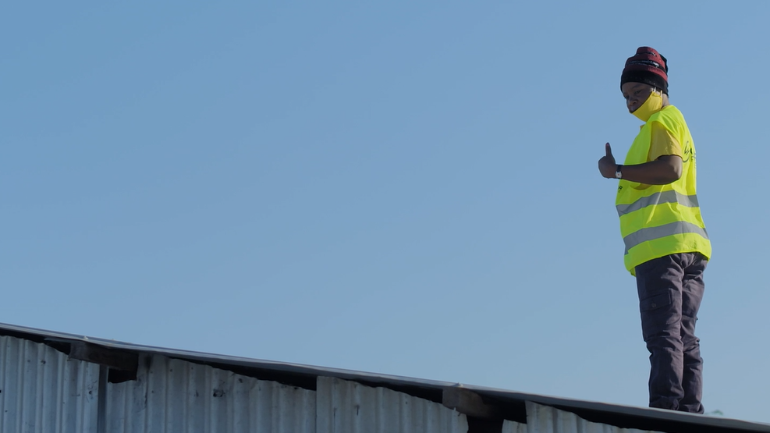
A global skills shortage
is blocking access to clean, affordable energy​

Slide 6
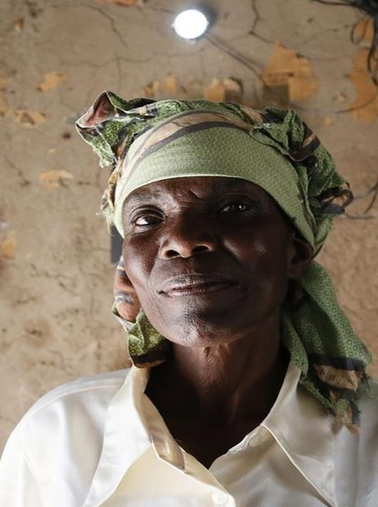
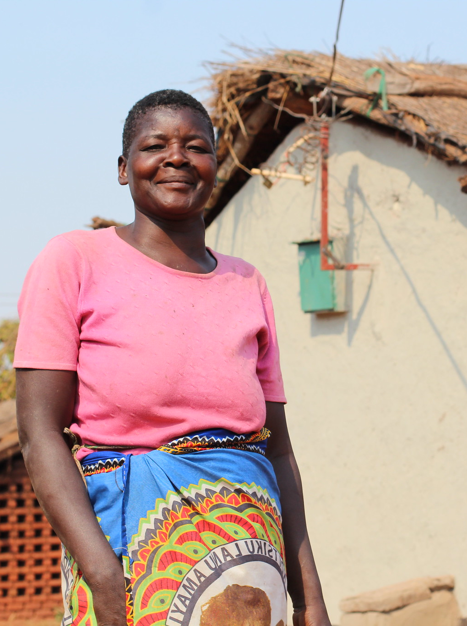
Skills development can help achieve climate targets, universal energy access and decent work
Providing clean, affordable and sustainable energy for all is crucial to tackling climate change and limiting future greenhouse gas emissions, while addressing global inequality and injustice. Decentralised renewable energy solutions – such as solar home systems, solar microgrids and efficient cookstoves – are vital to creating energy access in the world's most remote and marginalised communities.
Such solutions also serve to create decent work, better livelihoods and fairer, more inclusive economies.
The clean energy transition in energy-poor regions presents such a huge opportunity because the impacts on jobs and livelihoods are twofold:
A skilled workforce is needed to deliver universal energy access, and this could create 4.5 million jobs by 2030 (IRENA, 2013)
Energy access has a livelihoods multiplier effect on local and regional economies: up to 5x more productive jobs could be created or enhanced through the use of energy, as in the energy sector itself (Power for All, 2019)
Image source: SCGJ 2021/Mlinda 2019.

Slide 7
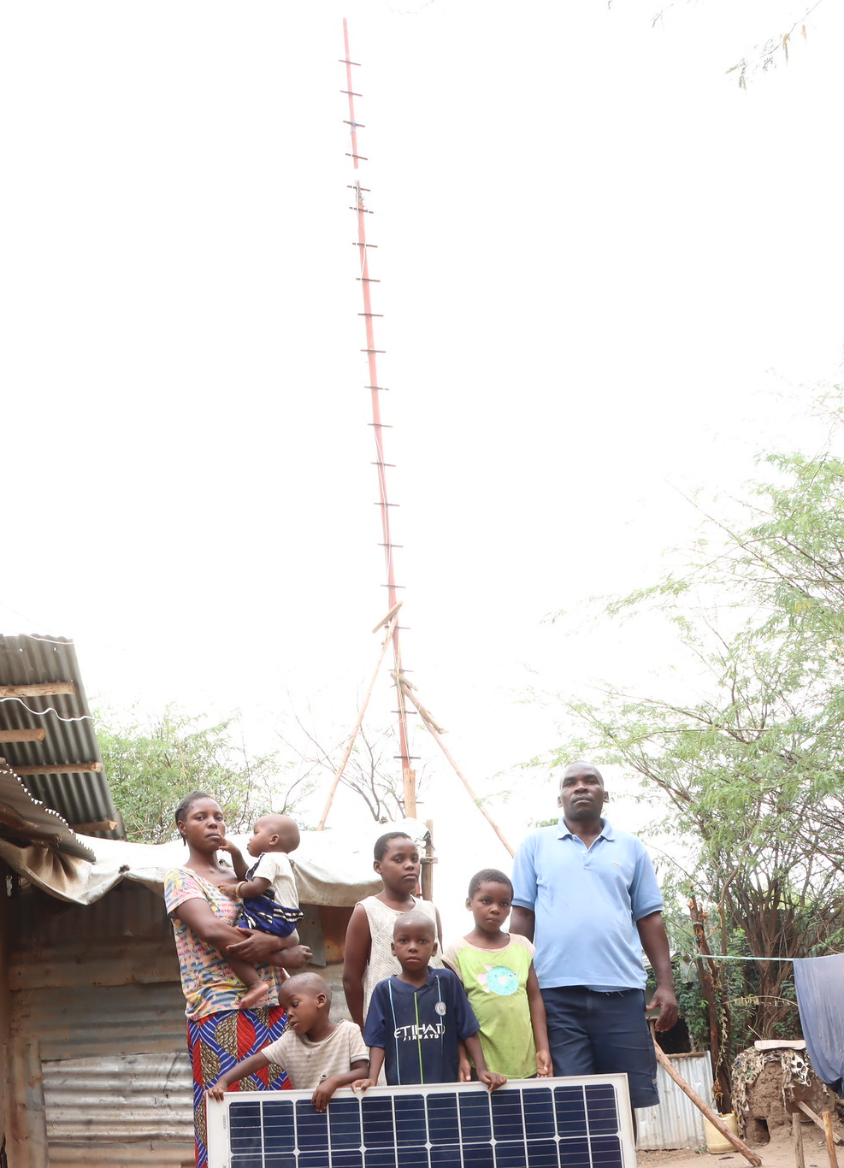

Skills development can help achieve climate targets, universal energy access and decent work (continued)
Despite the huge opportunity, the world is currently not on track to meet SDG7, universal energy access by 2030, and there are multiple barriers to overcome in achieving this, including rapid scaling of supportive policy environments, financing, last-mile distribution (including in humanitarian settings) and human capacity.
So why the focus on skills and capacity?
According to the World Economic Forum (2018) ‘human capital, which encompasses digital, technical, and vocational skills, is the area that is least prepared for the energy transition in emerging economies. In other words, the energy workforce of the future lacks the necessary skills to fully realize the transition.' The energy access sector is a part of this picture. Human capacity is also an area that, historically, has received less of a spotlight than other levers towards SDG7, such as financing or programme-level support.
A focus on skills also allows governments to meet multiple policy goals at the same time – around jobs, livelihoods, climate and energy. Conversely, the opportunity cost of not prioritising energy access skills is huge: ‘The lack of a skilled energy access workforce in emerging markets may hinder the achievement of government electrification targets, slow down the growth of more resilient energy infrastructure, and limit the potential of the energy sector to unlock major employment benefits.’ (Shirley et al., 2020).
The nature and size of DRE markets are very different across countries. The observations in the presentation skew towards India and East Africa, regions with large and established DRE markets.
Image source: Kakuma Ventures

Slide 8
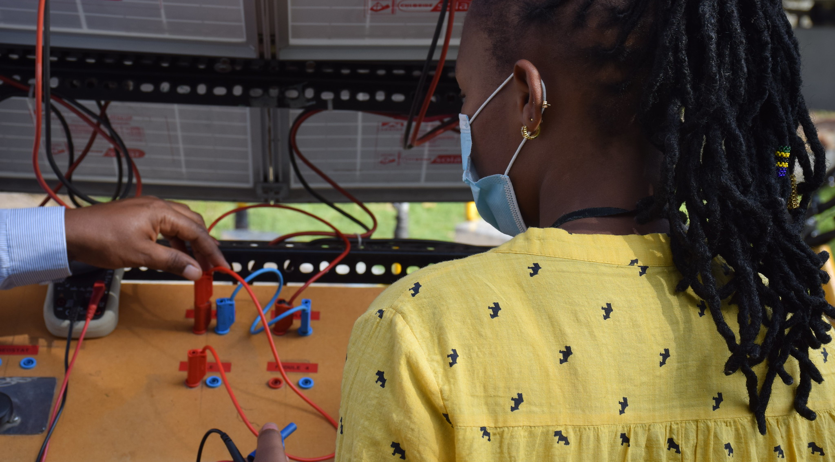
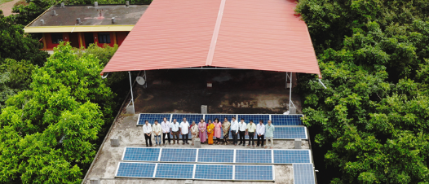
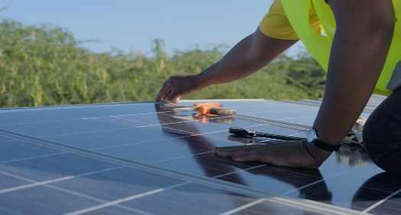
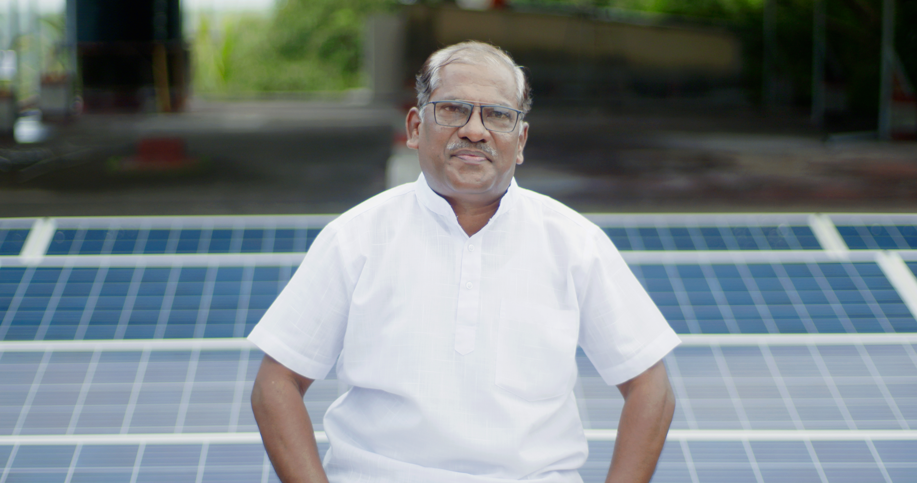
Quantifying the skills gap in two key geographies:
India and sub-Saharan Africa
The biggest skills gap is in sub-Saharan Africa - 600 million people lack access to electricity, but there are only 76,000 jobs in renewable energy across the continent (IRENA, 2018).
Approximately 12 to 13 million young people across Africa enter the job market every year, but just three million get formal jobs (ADB, 2018). The energy access sector as a whole is less well-known in SSA than in India, so it can be hard to convince young people to move into a field their parents and teachers do not know about [RS].
Some large-scale government-led efforts in SSA have yielded results at scale, for example, Nigeria’s Rural Electrification Agency created 5,000 jobs in 2018 (Power for All, 2018) and the Togolese Agency for Rural Electrification enabled the training of 3,000 technicians as part of its electrification roll-out.
By contrast, in India, there are half as many people without electricity and 10 times more people working in the solar PV sector alone (Shirley, 2018) with a more mature energy access market and more facilities for training and brokering candidates and the job market (RS).
The skills gap in India is huge, but there is significant government-led activity that is helping tackle this: ‘India is pushing to build 175 gigawatts of solar and wind energy by 2022. Achieving this goal will require 300,000 renewable energy workers, a substantial increase on current numbers.’ (Power for All, 2018). There are also significant skills pushes through the Skills Council for Green Jobs, which are going a considerable way to address technical training (although not necessarily other skills gaps) (IR).
In India, an increased focus on decentralised solutions like rooftop solar and microgrids can significantly increase the job-creation potential of India’s 500 gigawatts non-fossil fuel electricity generation capacity target. 'The distributed nature of these projects makes them more labour intensive than utility-scale projects, thereby increasing the jobs created across the project deployment cycle' (CEEW et al. 2022).

Slide 9
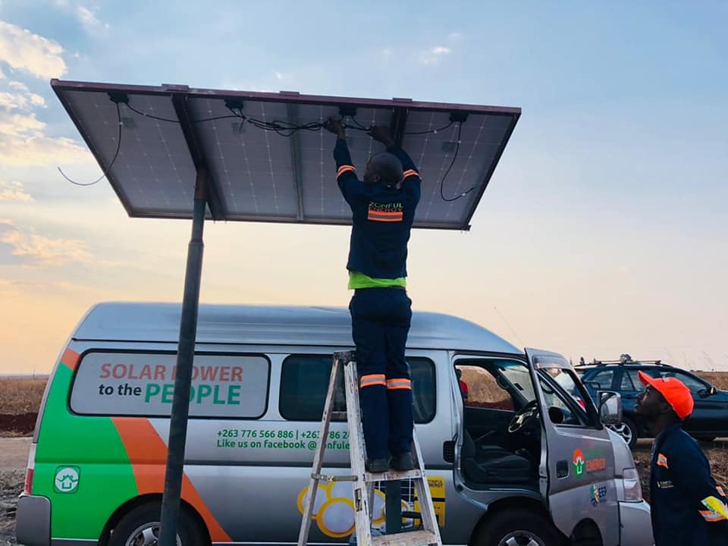
Effective solutions to close the skills gap already exist ​

Slide 10
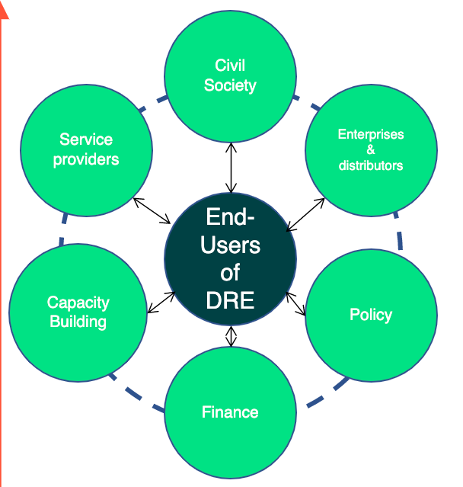

The Energy Access Ecosystem – with a jobs, skills and livelihoods lens
Throughout the presentation, we refer to different parts of the energy access and training ecosystems, as well as adjacent sectors. This diagram sets out, in simplified terms, how these link together.
Energy access can be a livelihoods catalyst for end-users:
- Farmers and agro-processors
- Other livelihoods e.g. textiles, micro SMES
- Social uses e.g. healthcare, schools
End-users are typically operating within other sectors – such as agriculture –
with their own ecosystems and capacity building initiatives – these are not well integrated with skills efforts relating to decentralised renewable energy.
A skilled workforce is needed across this ecosystem to deliver universal energy access.
Innovation on building this capacity could be delivered by:
Technical, vocational and educational institutions
Including regional technical training centres, rural and agricultural training centres, training focused on health and social care etc.
Intermediaries e.g.
Incubators/accelerators
Impact investors
Industry Associations
Development programmes – e.g. rural development
Farmer producer organisations or cooperatives
Energy enterprises themselves
Focusing on own staff or end-users
Where there is a specific need, or philanthropic funding They often lack resources for this
Partnerships e.g.
Governments or institutions working with enterprises (or any combination of the above).
These can be:
- Local/national/regional/international
- Public
- Private
- NGO/ civil-society led
Adapted from SELCO Foundation (2019) and conversation with Huda Jaffer (2021)

Slide 11

Solutions to
close the skills gap:
Creating an enabling framework for DRE skills and jobs at a policy level and fostering collaboration
1.1 Planning, coordination and prioritisation of resources for DRE skills at a national government level
Progress, at scale, to upskill the future DRE workforce will require planning, coordination and prioritisation of resources at national and local government levels (FFI India). A number of pioneering governments, including Togo, Nigeria and India, have started to play an active role in facilitating DRE skills roll-out, taking on important roles, for example as facilitators, regulators, and financiers, and coordinating recruitment and training across public and private sectors (Ashden, 2022).
1.2 Integration of DRE skills programmes with those in adjacent sectors
Increased access to clean energy always serves other development goals. Policymakers should support the integration of energy access skills training within (often pre-existing) ecosystems that are served by DRE, such as rural livelihoods, agriculture and health, which often have more established training programmes and infrastructure (HJ, AJ). Similar skill sets may be needed in sectors adjacent to DRE, such as heating, transport and national grid infrastructure (REN), as well as more traditional employment sectors, such as construction and electrical engineering. Policymakers have an important role in coordinating skills training across sectors and enabling graduates in more traditional sectors to build on their skills with a renewable energy focus (NRDC, 2016).
1.3 Innovative partnerships and intermediaries to support governments
Partnerships, particularly between the public and private sectors and academic institutions, are essential to achieving this level of coordination and integration (HJ, CM, JMK). Intermediaries, including NGOs and industry associations will be important in facilitating these partnerships (ARE, HJ). National and regional-level energy access entrepreneurship and support facilities, such as ECOWAS and SACREEE in West and Sothern Africa, can play an important coordinating role across sub-Saharan Africa. International NGOs and coalitions such as Power for All, CORE and REN21, as well as nationally-focused stakeholders such as SELCO Foundation, are already acting as intermediaries between stakeholders.

Slide 12
Solutions to
close the skills gap:
Creating an enabling framework for DRE skills and jobs at a policy level and fostering collaboration - continued
1.4 Building the data and business case for investment in human capacity
Power for All's Powering Jobs research, and other recent studies from the likes of IRENA and CEEW have been foundational in building the data on the DRE skills needs and opportunities across a number of countries. Globally, much more of this sort of work is needed to set out the business case for investment in this area.
In particular, governments must see how investment in DRE skills can help achieve other policy goals, such as decent jobs, rural livelihoods and climate targets. There is a role for intermediaries and third sector organisations to fulfil this advocacy role and share lessons from successful work to date. An example of a successful government DRE programme with a strong skills component is the Togolese government's CIZO programme (case study available here).
By the same token, greater transparency by governments in the provision of planning and market information will also help the sector to grow and innovate (Power for All, 2020).
1.5 Integration of DRE into large government skills training and implementation programmes as a route to scale
India is investing in skills development at scale (see case study). Here, training at scale is often driven by large government electrification and public health programmes, which require training of multiple people within a region, who can subsequently deploy those skills elsewhere. The practical application of this training is essential to its success (HJ). Nonetheless, these programmes tend to focus on technical skills, and there remains a big gap around soft skills, such as marketing, sales and business (AJ).
Interviewees in India’s DRE sector point to the importance of institutionalising DRE training as a route to scale, so it does not depend on individuals or enterprises, for example by integrating it with large training programmes such as those under India's Skills Council for Green Jobs (AJ, HJ). The equivalent doesn't yet exist in most African countries (ARE).

Slide 13
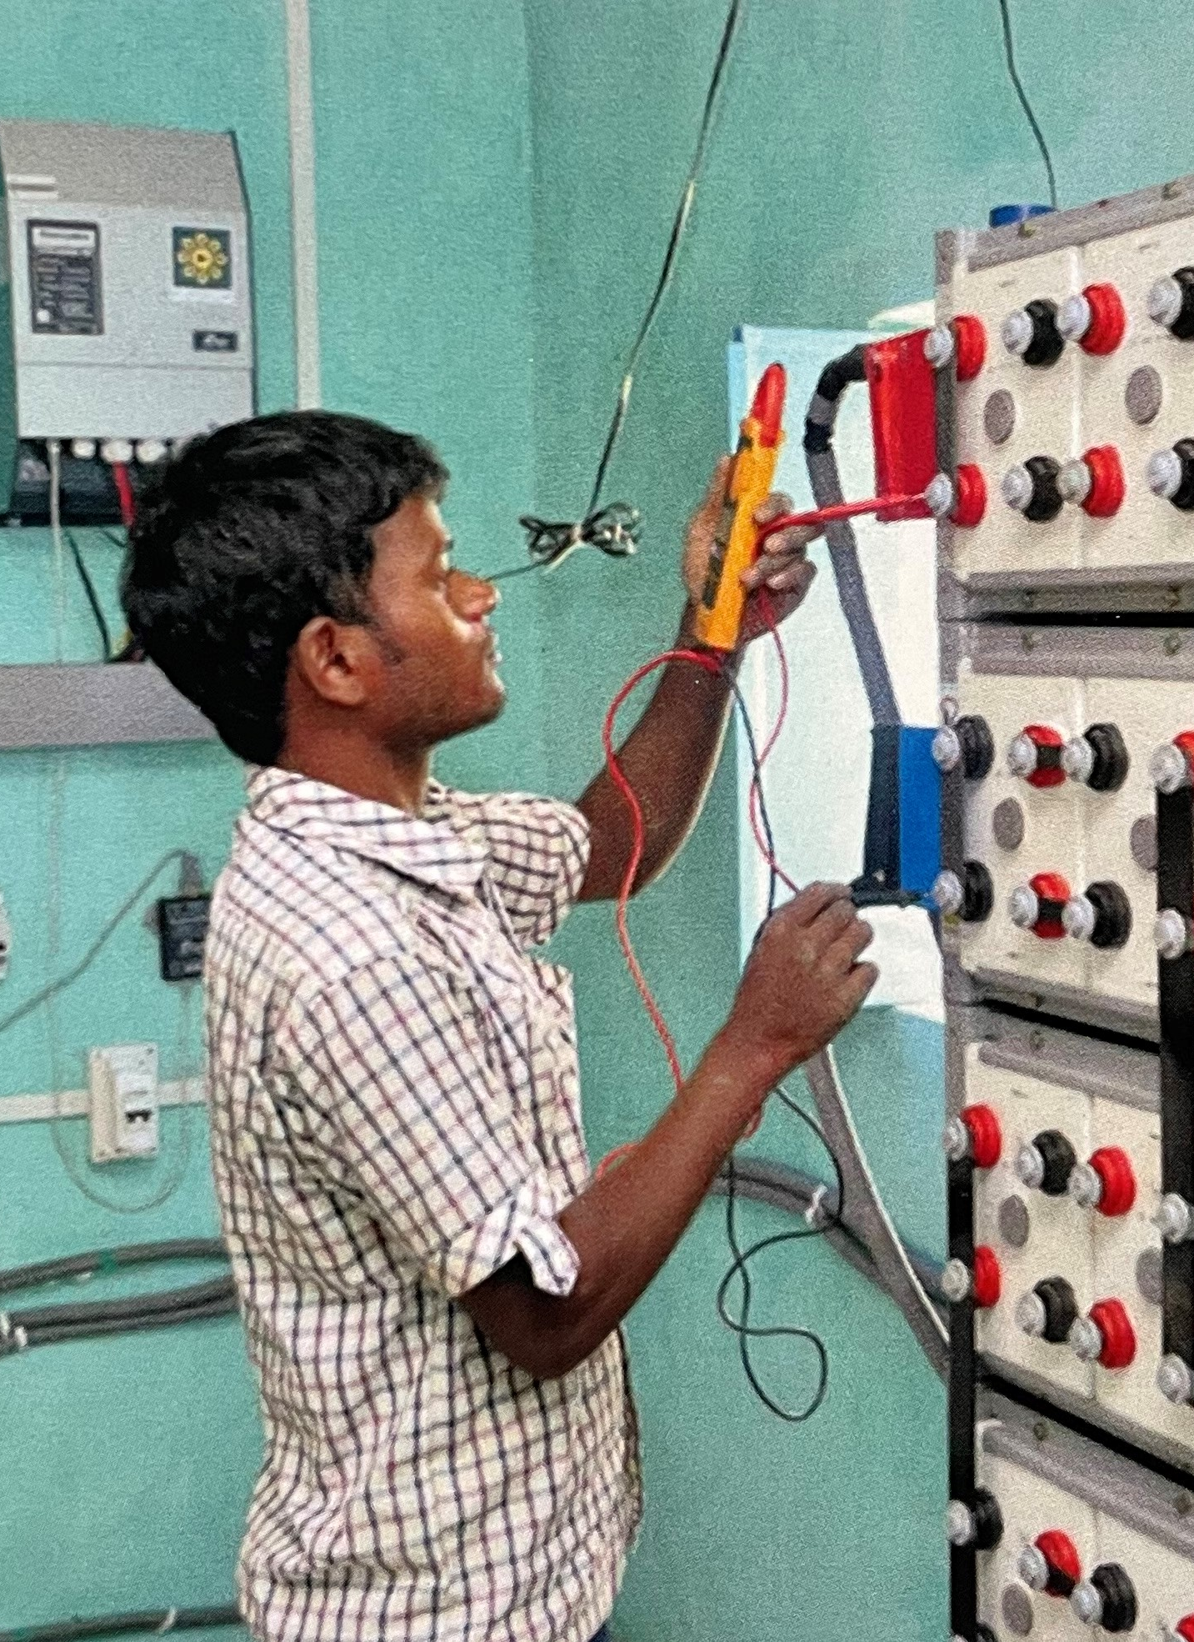
Case Study
India’s holistic policy and capacity building
Even prior to its commitments at CoP26, the Govt. of India has been working to institutionalise capacity building for green jobs and DRE. One such measure was the establishment of the Skills Council for Green Jobs (SCGJ) in 2015 . The SCGJ has over 500 training partners across the country; more than 78,000 trainees have been certified under the national-level solar energy Suryamitra training program, focused on growing youth skills in solar energy.
SCGJ believes that a critical step in developing a workforce to deliver India’s renewable energy targets is to identify the missing skills and job potential of the sector. The council has conducted a skills gap study in the Indian RE sector and an occupational map for employment opportunities, cross-verified by sector experts and the industry. SCGJ has also developed two Greening National Occupation Standards (NOS) to mainstream green skills in the training delivery across all job roles.
A draft policy framework was released by the Indian govt. earlier this year to promote job opportunities in DRE in livelihood applications, and as part of this framework, a green jobs portal has been launched by the SCGJ, helping connect the talent to employment.
Image source: SCGJ 2021/Mlinda 2019.
Notes:
C-Camp an Indian government partner tech incubator is integrating DRE across its existing portfolio for the first time (AJ).

Slide 14
Togolese government - skill building through electrification
Case Studies
Power for All as an intermediary
The Togolese Agency for Rural Electrification is accelerating national electrification rate through the CIZO project, by focusing on the conditions needed to facilitate operations of the private sector, not just in terms of the regulatory and financial environment, but also skills training. KYA-Energy Group, a Togolese solar company, has established five solar academies in Togo for training over 3,000 technicians in courses lasting three weeks - beginning with recruiting and training 60 experienced electrical engineers to deliver sessions to trainees. Additionally, consultancy Horus ran day-long courses to train 40 PAYGO agent supervisors who would be employed by the country’s postal service (a major stakeholder in the project). These supervisors went on to upskill and manage 3000 payment agents across the country (these agents are generally owners or employees of local small businesses).
Intermediaries play a critical role in bringing together key sector players for knowledge-sharing and building partnerships. Power for All has established country-level steering committees in Kenya, Nigeria, India, Uganda and Ethiopia, with leaders from DRE, nexus sectors and government, along with a global steering committee. The role of the steering committees is to to share and validate findings from their annual energy access jobs survey, craft the Powering Jobs campaign together, maintain continued engagement on jobs in DRE at both global and in-country levels, and support policy and finance interventions.

Slide 15

Solutions to
close the skills gap:
Financing skills and capacity development for the energy transition
2.1 Building the capacity of the entire DRE enabling ecosystem – including the finance sector
It is not only those implementing clean energy solutions directly that need capacity building. The ecosystem that surrounds the sector will be critical for its growth and financiers, policymakers, suppliers and other service providers all need to understand the opportunities presented by the sector and have the right skills to play their role in supporting its growth. Skills training curricula needs to cut across all these categories.
Particularly in India, there have been a number of interesting initiatives aimed at up-skilling operatives across the finance sector, including that of Bharatiya Vikas Trust in Karnataka (HJ). Financial sector employees often do not understand how DRE products and markets work (FG2-JM) and upskilling is needed across the financial value chain, from the last-mile banking correspondent to the people doing due diligence, structuring loans and creating financial products (HJ, FG2-KV).
2.2 Enabling funders to see the importance of investing in skills, as well as implementation
Interviewees emphasised that significantly more funding, of all types, needs to go into tackling the skills gap, especially for marginalised communities. Many interviewees report that this is currently not a strategic priority for the funding and investment community, who tend to favour investment in direct implementation rather than human capacity. Encouragingly, our 2022 Energy Access Skills Award process has uncovered several recent small-scale skilling initiatives particularly in SSA that are being funded by bilateral/multilateral donors, indicative of injection of capital 3-4 years ago.

Slide 16
Solutions to
close the skills gap:
Financing skills and capacity development for the energy transition - continued
2.3 Increasing the knowledge of large donors on where to invest for maximum impact
It is not only those Many large donor agencies, such as the World Bank, are required to allocate funding to capacity building in DRE programmes, and in a position to advise governments, but lack information on best practice and key local actors and institutions to maximise impact. NGOs and intermediaries can help to equip these large donors with examples of effective and inclusive approaches and key contacts to ensure the capacity building work is effective and inclusive (ARE).
2.4 Encouraging a dedicated focus on skills
Shell Foundation pointed out that financing for skills and capacity development is rarely funded in its own right; it is usually a part of a wider energy access project with the lenses of agriculture, gender or enterprise development, and sometimes it doesn't receive the dedicated attention it deserves. However, certain funders are starting to buck this trend. Through the African Climate Change Fund, the Africa Development Bank is working on training youth and women in business and entrepreneurship skills in the sustainable energy value chain in Uganda and Kenya. There are now venture funds that are interested in the development of SMEs with a strong skills dimension, for instance, ANDE is providing SMEs with critical financial, educational, and business support services which includes skills development (SF).

Slide 17
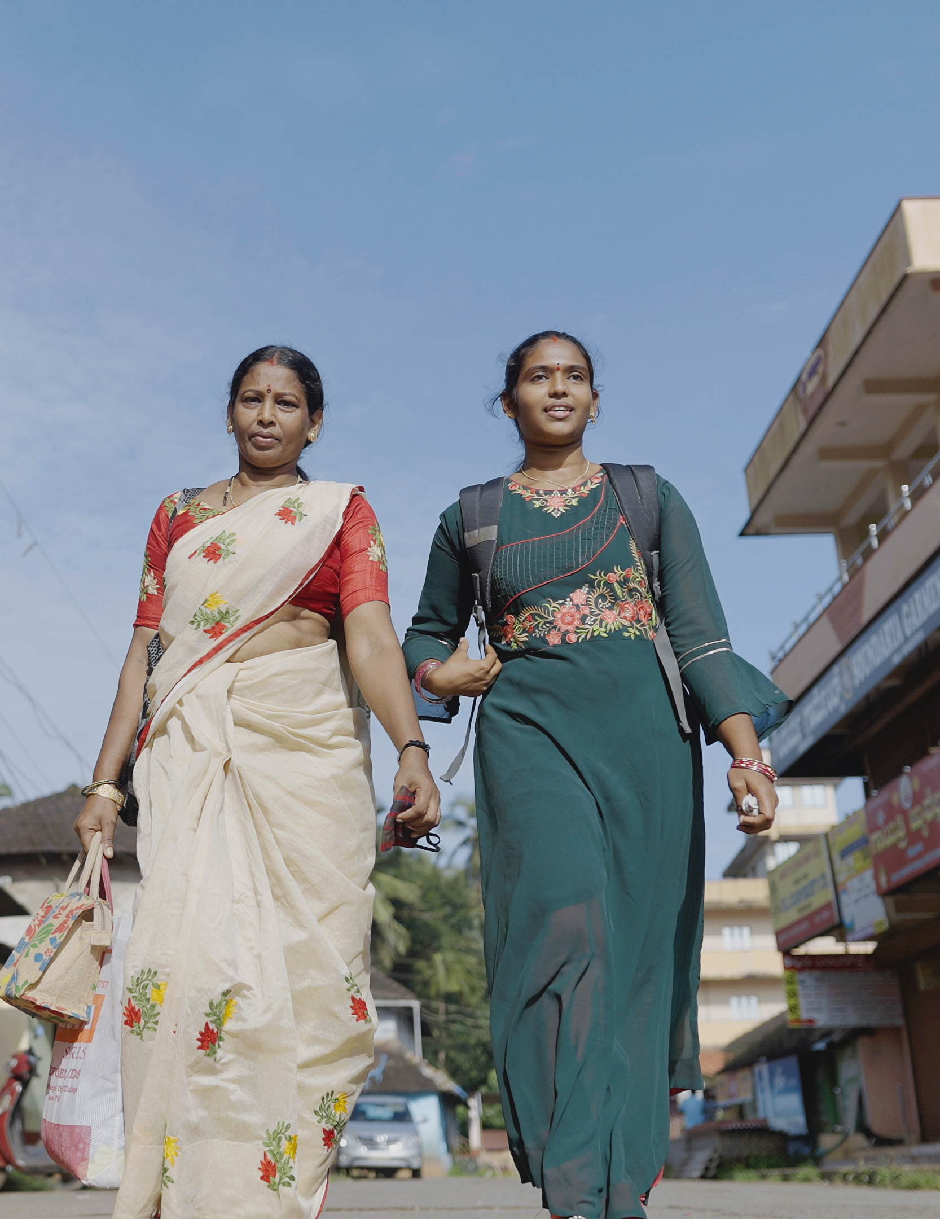
Case Study
Upskilling the finance sector - BVT
Bharatiya Vikas Trust (BVT) in India upskills bank staff and managers, giving them the knowledge and confidence to lend to renewable energy enterprises. This innovative approach closes a ‘finance gap’ that limits the spread of clean energy as a means of making a living.
The programme has trained more than 14,500 financiers (from banks, cooperatives and government departments, and across all levels, from field officers to executive leadership) to increase their awareness of the viability of different DRE solutions and help them select financial products suited to their cash-flows. As a result of this training, BVT has facilitated the deployment of 600,000 solar systems via local bank funding.
BVT also trains entrepreneurs, with courses offered specifically for women; the training includes business planning information and an introduction to financial institutions.
As well as financial training, BVT trains local NGOs in empowerment of women and inclusive governance. The trust empowers marginalised communities by hiring local staff, offering training in local languages, and creating strong partnerships with local NGOs and village councils.
Notes:
C-Camp an Indian government partner tech incubator is integrating DRE across its existing portfolio for the first time (AJ).

Slide 18

Solutions to
close the skills gap:
Developing standardised, industry-aligned curricula, accreditation and recruitment channels
3.1 Development of standardised curricula that reflects DRE industry needs
DRE is not part of mainstream academic curricula yet. DRE enterprises in SSA and India currently have to recruit candidates from many different training centres, with widely varying accreditations and quality of training. Standardised, accredited, industry-aligned curricula will enable skilled people to fill opportunities across different geographies and speed up the supply of trained candidates (ARE; Shirley et al. 2020). There are already examples of individual institutions taking the lead in this area, such as the Strathmore Energy Research Centre (SERC) in Kenya, as well as cross-academia partnerships, such as the TEA-Learning Partnership which is supporting multiple universities to develop and implement first-of-its-kind DRE curricula.
3.2 Close collaboration and knowledge transfer between educational institutions, industry and government
Close collaboration will be required between educational institutions, the DRE industry and government to develop, replicate and co-ordinate these efforts at national and regional scale (ARE). Schools and universities have a central leadership role to play, but just as critical are vocational institutes, rural training colleges and non-traditional training providers such as accelerators, NGOs and industry associations. Intermediaries and third-sector organisations will be important in supporting knowledge transfer and replication between institutions (REN; ARE, SG P4A). There are a number of examples of this including The Cornerstone of Rural Electrification (ARE) programme's early-stage work developing certification frameworks for DRE practitioners with education and government partners.
3.3 Multi-disciplinary curricula​
​
In Kenya, SERC has called for more curricula focused on multi-disciplinary skills and cross industry collaboration, in the mould of their recently-launched Sustainable Energy Transitions MSc which gives students an introduction to the energy ecosystem, multi-disciplinary exposure and management and communication skills. They hope future intakes will include graduates in adjacent sectors such as IT, law and business to ensure that the DRE sector benefits from the full range of expertise needed for its rapid growth (SERC).

Slide 19
Solutions to
close the skills gap:
Developing standardised, industry-aligned curricula, accreditation and recruitment channels - continued
3.4 Effective recruitment channels to match skill candidates with DRE jobs
A broader range of recruitment channels matching skilled candidates with DRE jobs is needed, particularly those tackling barriers such a recruitment biases and digital exclusion (JKM, HJ, Shirley et al. 2020). The Togolese government found that even free DRE training courses have a high drop-out rate if participants are not convinced that there will work for them in the years ahead (Ashden, 2022). Dedicated job platforms, such as Shortlist, operating in over 20 countries globally, and Zonful Enterprises, focusing on Zimbabwe's DRE sector specifically, need support to grow, be replicated, with mainstream job platforms also integrating DRE into their offering.
3.5 Practical, industry-linked career development and advisory programmes
Practical, as well as theoretical, training is needed. Even when candidates have a certificate to prove competencies, they do not necessarily have the ability to apply this in the real world (JMK, Ashden, 2022). Practical, industry-linked career development and advisory programmes, including components such placements, job fayres and good careers advisory services, will be essential in providing routes into real-world jobs (Shirley et al. 2020; RK, REN). This will also help young people know about the opportunities in the DRE especially important in SSA where visibility of the DRE sector is low among students and graduates.
Scholarships, funded training, mentorship schemes and apprenticeships are a means to open up opportunities for people from disadvantaged backgrounds (IRENA, 2021).

Slide 20
Solutions to
close the skills gap:
Developing standardised, industry-aligned curricula, accreditation and recruitment channels - continued
3.6 In-work career development for middle managers and the importance of soft skills
In-work career development for those in the DRE, and adjacent sectors, is critical to help enterprises scale quickly, and to allow local talent to progress in their careers. The middle management skills gap is one of the most frequently cited challenges by DRE enterprises, a trend often exacerbated by competition on salary from other industries and international companies (FG2-KV and others). Soft skills are the most frequently cited gap, which includes skills in business, management, finance and leadership. In Kenya and Nigeria, management, business development and finance roles are the hardest to recruit for, but also the most critical for future growth of the sector (Shirley et al. 2020).
A range of organisations are developing innovative curricula and delivery models for on-the-job skills training and for middle management development. These include professional institutes, such as industry associations (SENDEA, Uganda and the Global Distributors Collective) and other NGO and civil society organisations. There are already a range of skills development coalitions in place (for example the Sustainable Energy Jobs Platform, TEA-Learning partnership). Developers of new curricula should engage with such entities, rather than duplicating routes to implementation (FG2-AS).
3.7 Technical skills development is needed in specific areas
Though technical skills can sometimes be a secondary concern for enterprises due to the possibility of providing in-house training (Shirley et al. 2020) many interviewees emphasised technical areas that will be essential to the energy transition. These include skills relevant to mini-grids and C&I (SERC), initiatives to develop home-grown high-end technical talent in areas such as smart-grids and digitisation (RK), as well as efforts to standardise and accredit technician training, and extend technical training opportunities to rural areas.

Slide 21

Case Study
AMI’s middle management skills programme
The middle management skills gap is one of the most frequently cited challenges in the energy access sector. The African Management Institute (AMI) offers one of the most established programmes meeting this gap – its Empowering Managers programme, established in 2019. The programme focuses on building the skills of mid-level managers in the energy access sector – in particular, skills for managing growing teams, business modelling, operations and understanding customers. Over 476 managers in 23 countries in 80 companies - including a mixture of international and local companies and those serving rural areas and the urban poor – have been trained so far. AMI has worked closely with the industry to design curricula that responds directly to its needs.
AMI is also working with Shell Foundation to explore sustainable financing mechanisms to help address talent barriers in a scalable way, via a Revolving Talent Facility (Shell Foundation, 2018). The revolving talent fund pool will allow impact ventures to take loans to train and hire talent; the loans can be repaid once the business has grown (SF).
Notes:
https://shellfoundation.org/app/uploads/2018/10/Investor-Portfolio-Overview-May-2018.pdf

Slide 22
TEA-LP – collaborative curricula development
Industry linkages for trainees – Shortlist, Zonful Enterprises and THI
Case Study
The TEA-LP is a partnership of 8 African universities collaborating to develop new postgraduate curricula for the energy access sector, supported by a central intermediary, the University of Cape Town. Partner universities are provided with both financial and technical support including workshops and webinars, to develop courses and degree programmes.
Each university tailors the curricula according to its strengths, and informed by their market engagement, but core TEA-LP principles apply across all programmes - responsive to sector needs, gender mainstreaming, multidisciplinary, soft skills and sustainability.
For instance, SERC, one of the partner universities, has a focus on making technical training available to women, offering subsidised training and specialised mentorship. SERC has also developed training that has been adopted and accredited by the National Industrial Training Authority.
Market linkages are essential to ensure that the training results in beneficial employment. Shortlist is one of the pioneers in creating these linkages, connecting employers to the right talent.
Zonful Enterprises has digitised the job market linkage process by developing an Uber-like mobile app where technically qualified youth can access job opportunities across the 8 rural provinces in Zimbabwe. The app lists short-term, long-term and commission-based opportunities.
Technische Hochschule Ingolstadt (THI), Germany has established the East Africa Network of Excellence for University of Applied Sciences Kenya (UAS), and in partnership with the universities and Kenya Renewable Energy Association, has developed an online database for internships, cooperative theses or general employments for students. It is an open-source software to make it easily transferable to other countries.

Slide 23

Solutions to
close the skills gap:
Decentralising access to training and certification
4.1 Taking skills development closer to rural communities and upgrading training facilities
While the implementation of most DRE projects is in rural areas, most training, especially in SSA, is centred on cities. Many people in rural areas, especially women, do not have access to these spaces. The irony is that rural areas and marginalised communities are the ones most in need of opportunities and have strategic advantages: knowledge of local realities and a physical proximity to projects (RS, FG1-CC)
Research from India's Skills council for Green Jobs also emphasises the importance of taking skills development closer to rural communities for the speed of mini-grid deployment (CEEW et al. 2022) with local, vocational and rural training colleges having a key role to play. In India, companies cite a physical lack of proximity to training institutes as a major barrier to finding talent. NRDC's recommendations include expanding training infrastructure, including establishing a solar training institute in each region with high solar potential (NRDC, 2016). Repurposing and up-grading existing infrastructure can also be a solution, for example, increasing spending on upgrading rural, vocational training centres to become hubs of entrepreneurship (SELCO Foundation/ IRENA 2022).
4.2 Innovation in distance learning and digital inclusion
Innovation in distance learning can help more people access training, but this must be combined with efforts to advance digital inclusion (IRENA, BC) both in accessing curricula remotely, but also in being able to access and use employers’ apps and equipment (FG2-NP). Training must be available in national and local languages, and in particular be available to non-English speakers (FG1-SK).
4.3 DRE training as an opportunity for workers transitioning away from fossil-fuel, and other, industries
There is also great potential to upskill the existing workforce, both in the formal and informal sector, especially reskilling those employed in unclean energy jobs to be able to apply their expertise in the DRE sector (FFI, NEN). The Togolese government's redeployment of electrical engineers from other sectors as trainers for the DRE workforce is an interesting example of this (Ashden, 2022).

Slide 24
Solutions to
close the skills gap:
Decentralising access to training and certification - continued
4.4 Building links to, and empowering, the informal sector
A huge proportion of jobs in energy poor regions are in the informal sector (82% in Kenya, 92% in Nigeria, according to Shirley et al. 2020). This includes roles like field and sales agent on commission. In SSA, informal-sector distributors play a significant role in getting clean energy products to people but their work is often insecure and outside of the net of formal training (JMK). Outreach forums for young people who have obtained skills in the informal sector or vocational training centres, and databases of recent graduates and skilled workers, could help connect them to opportunities (Shirley et al. 2020). Similarly, training institutes need to be made more accessible for informal sector workers for example through outreach programmes and funded places (JMK).
4.5 Improving social protections and work standards for the informal sector to reduce job insecurity
Given the precarity of the informal sector, industry associations, and other campaigning organisations, can help informal sector work in DRE to align with global and local work standards and social protections (Shirley et al. 2020). Across SSA international standards often prevent hiring of local people with skills but no certification. Solutions are needed to ensure both inclusiveness of local talent and quality assurance (RS) as well as compatibility of standards across countries and regions, something that inhibits job mobility (SCGJ).
4.6 Building the skills and capacity of civil society organisations at a local level
The voice of local civil society is often missing in conversations around skills – this is needed so work can be informed by the needs of the people it serves and ensure value creation/retention at the local level. SELCO Foundation in India emphasised the importance of DRE implementers engaging with NGOs and CSOs on integrating energy access into their work, for example on livelihoods (HJ). New Energy Nexus Uganda have an organisational focus on building the skills of pre-existing social businesses, who already have a deep connection to and understanding of local needs, to become clean energy entrepreneurs and distributors.

Slide 25

Case Study
Building the capacity of community businesses - NENU
As an intermediary, New Energy Nexus Uganda (NENU, formerly Enventure Enterprises) plays a unique role helping local community-based organisations bring affordable renewable energy to their communities. NENU provides these grassroots organisations business training and mentoring, and credit to buy clean energy products such as solar lanterns, briquettes, water filters and cookstoves, which they sell at affordable prices to the locals. Once organisations have established a successful business model, they qualify for further support and larger loans to buy more products and invest in marketing and sales teams.
The training includes a three-day bootcamp on topics including finance, marketing, sales, accounting and management, support from mentors for a three-month period and links to peers through peer support groups and WhatsApp/Facebook. Other innovation from New Energy Nexus Uganda includes an offline bookkeeping app for small merchants and street vendors.
Notes:
C-Camp an Indian government partner tech incubator is integrating DRE across its existing portfolio for the first time (AJ).

Slide 26
Case Studies
Upskilling for a just transition – Mee Panyar
Pollinate Group’s efforts towards digital inclusion
Mee Panyar is helping villages in rural Myanmar transition from diesel to solar power through inclusive hands-on technical training and community mobilisation programs. They empower communities to install and maintain their own solar microgrids, ensure that communities are supported to reliably operate the system, and maximise the benefits of electrification through local ownership.
Mee Panyar leverages the country’s 13,000 existing diesel mini grids as learning tools for rural electricians by training them to hybridise/ solarise their infrastructure, and also provides them with access to finance. Alongside the solar system, community members also work together to incubate emerging sustainable businesses, catalysing long-term economic development.
Pollinate Group is a woman-led global social enterprise that brings access to clean and affordable energy products to neglected communities living in poverty in India and Nepal. Women from the most marginalized groups are empowered with the skills, knowledge and support to become clean energy entrepreneurs.
Pollinate recently launched an online Learning Management System which offers product training and on-the-job training in Hindi for the women entrepreneurs. For those without digital connectivity, Pollinate is in the process of procuring smartphones to facilitate access to the training system. Digital inclusion, especially in remote areas with marginalized communities, widens access to skills and green jobs.

Slide 27

Solutions to
close the skills gap:
Addressing barriers to participation in the DRE workforce for women
5.1 Tackling the deep-rooted, systemic barriers that prevent women participating in the DRE workforce
Almost all enterprises we spoke to, across multiple geographies, mentioned specific challenges women face in accessing skills and job opportunities. At an enterprise level, companies have difficulty recruiting women, even if they have specific targets to do so (CM, Southern Africa).
There are a wide range of practical, cultural and access barriers that women face in entering the DRE workforce. This includes 'equal-pay legislation; policies to accommodate caregiving responsibilities and provide better work-life balance for all employees, such as parental leave and part-time work; access to education and training programmes through post- secondary courses, internships, scholarships and apprenticeships; and gender targets and quotas to ensure a critical mass of female employees at all levels of management, as well as in technical and operational roles’ (IRENA, 2021)
5.2 Addressing the needs of rural women specifically
Across India, women are significantly underrepresented in the value chain and this is exacerbated by a clear wealth-divide in access to skills and qualifications, meaning the needs and circumstances of rural women are largely overlooked (FG1-SK). The barriers to access can be very different at different levels, for example sales functions in rural areas may be inaccessible without a vehicle or the ability to travel alone (FG1-CC, AJ).
5.3 Partnerships between DRE companies and socially-focused NGOs
Companies can improve women’s access to the workforce by partnering with NGOs and community organisations, with strong pre-existing networks and an understanding of the specific challenges women face, who can support on community mobilisation, awareness-raising and dual co-financing (FG2-AS; IRENA, 2021). For example, Promethean Power Systems, a social enterprise in India providing village-level refrigeration for small dairy farmers, has partnered with local development NGO Swayam Shikshan Prayog (SSP). SSP supports Promethean with recruitment of women within the operations, as well as providing the support and capacity building they need.

Slide 28
Solutions to
close the skills gap:
Addressing barriers to participation in the DRE workforce for women - continued
5.5 Thinking outside the box to include women in rural value chains
Frontier Markets, in India, has a specific focus on overcoming barriers to women’s participation in the last-mile distribution of clean energy products. For example, they have created a ‘day-time darkroom’ to allow women sales agents to show the benefits of the solar lighting products during daylight hours. They also encourage companies to look beyond the traditional roles for rural women in the DRE value chain, such as sales agents and distributors, and also build their skill sets in areas like data collection, maintenance and service provision to give women a broader skills base and a strong incentive structure (FG-FM).
5.4 Supporting women practically and financially to access DRE training opportunities
Women in SSA often need additional practical and financial support to access training opportunities. SERC found that having a dedicated women-focused engineering programmes, with fully funded places, and the opportunity for women to sign up with their partners, has been necessary, although they still found it very hard to recruit rural women to this Nairobi-based course (SERC). Sometimes women are not able to attend training alone, so provision of group support is important (JMK).
Building women’s confidence, self-esteem and interview skills are essential elements of levelling the playing field. In east Africa, a regional programme at tertiary level to prepare female students for the market has been suggested (CM).
5.6 Building on existing gender-focused skills initiatives
There are a number of international initiatives focused on women's skills development for the DRE sector. The Women in Renewable Energy in Africa Network (W-REA) is a mentoring programme launched by the International Finance Corporation in partnership with Global Women’s Network for the Energy Transition (GWNET) and Energy2Equal to address the gender gap in DRE and help especially mid-career women professionals through training for soft skills including leadership and management, networking support and career goals development (DR). ENEL Foundation and Sustainable Energy for All have collaborated on the Open Power Africa programme to provide mentorships, job shadowing and technical training with a particular focus on women's participation.

Slide 29
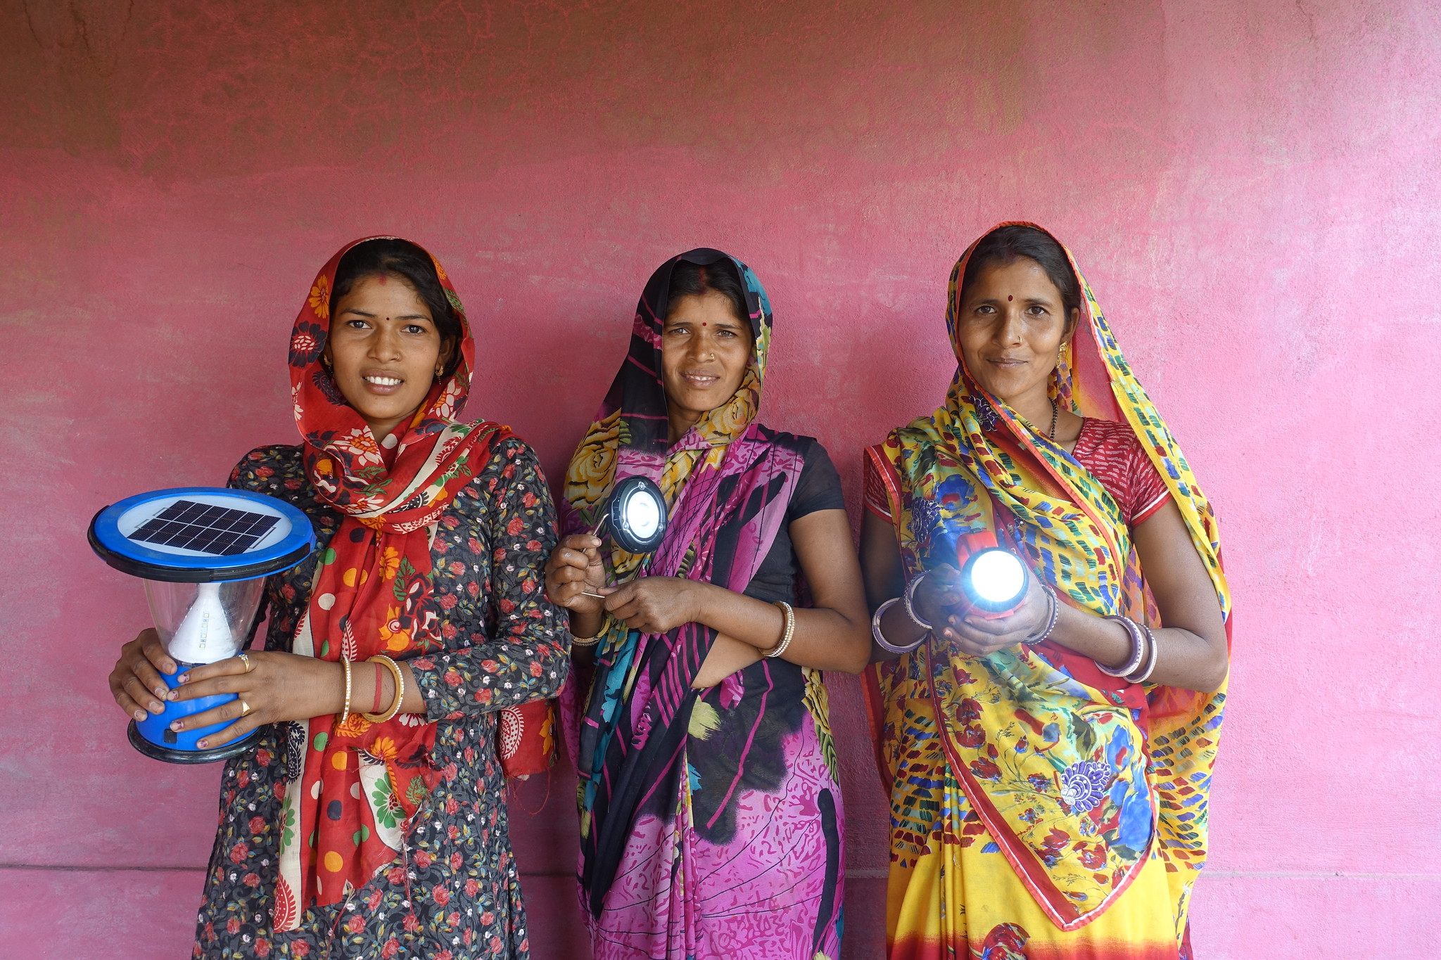
Case Study
Frontier Markets creating cultural shifts
Shifting cultures and intentionally removing biases is an important step to empowering women and enabling their increased participation in the DRE workforce. Frontier Markets (FM) in India is addressing this by tackling what they see as the ‘acceptance/dependency’ culture of rural Indian women.
FM trains women, the Solar Sahelis, in marketing, finance and record keeping - and recently technical skills through an e-commerce app - and gives them access to affordable finance and a range of products to sell. The Sahelis go on to become solar sales agents and undertake small repairs. This is the first significant income for many sahelis, and they take great pride in the enhanced reputation it brings to them and their families. They enjoy the opportunity to make their own choices on spending, and the freedom of not having to ask their husbands for money.
FM works in partnership with governments and NGOs which help the sahelis form Self Help Groups (SHGs) to encourage mutual aid, help access banks and public services, set up enterprises and in some cases, maintain their own funds which are available as loans, making the sahelis more independent.
Notes:
C-Camp an Indian government partner tech incubator is integrating DRE across its existing portfolio for the first time (AJ).

Slide 30
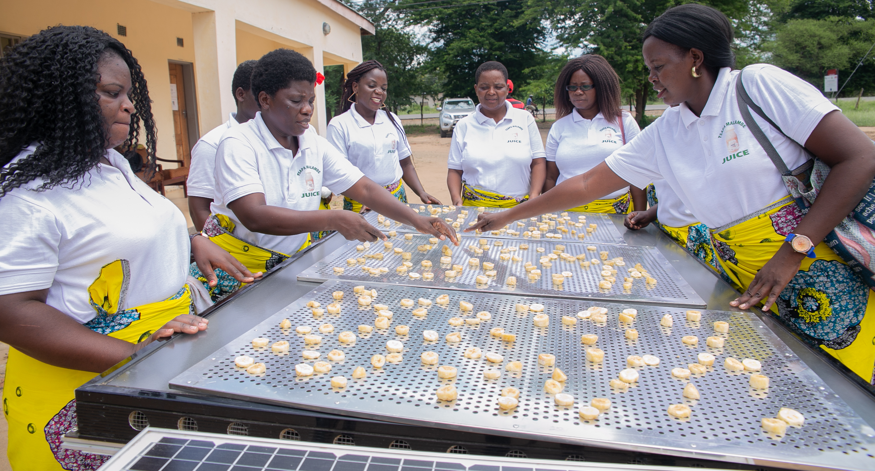
Training young Mamapreneurs – BleaGlee EnergySkills
Christian Aid supporting women’s energy cooperatives
Case Studies
The ‘Bleaglee EnergySkills’ is a women-led initiative, training women and youth between the ages of 18 and 35 in energy skills, in Cameroon, Nigeria and Mozambique. The training covers production, operation, installation, maintenance, distribution and repairs of renewable energy systems as well as climate-smart agriculture. Bleaglee EnergySkills works with locally rooted women groups for the training, and partners with energy companies for job placements of trainees, improving entrepreneurship and gender equality. Rural women, the Mamapreneurs, also receive training, resources and on-going mentorship to own and operate renewable energy businesses in their communities.
The trained women run and manage their own community training centres, bringing down the cost of training and making the programme more accessible.
Christian Aid’s Breaking the Barriers (BTB) programme supports women in remote off-grid communities in Burkina Faso, Ethiopia, Malawi and Honduras to create and run their Women’s Led Sustainable Energy Enterprises (WLSEEs), through which they receive training in sustainable energy products and technologies, business skills and have access to financial support in the form of both grants & loans. The groups members also undergo training in cooperatives management and group dynamics.

Slide 31

Solutions to
close the skills gap:
Supporting the wider needs of enterprises
6.3 Acknowledging the full spectrum of challenges that energy businesses face
Training developers and funders should acknowledge and, where possible, address the full spectrum of challenges that energy businesses face: the skills gap is just one of these. Access to finance for inventory purchase, end-user finance, piloting and growing the company, as well as clarity on tax and regulatory affairs are all mention frequently by enterprises as barriers to growth (LL).
6.1 Supporting the private sector to play its role in addressing the global skills gap
The responsibility for training staff currently falls most often to DRE enterprises themselves, in the absence of other training facilities or job-ready candidates. This is unsustainable given the scale of the energy transition needed as most simply lack the time and resources, as well as the ability to deliver certain sorts of soft-skills in leadership and business (many interviewees made this point). Nonetheless, an engaged and properly supported private sector is critical to scaling DRE skills, and can deliver on work-based training, promotion of national standard and informing the development of curricula and programmes. Innovation will be needed in the sphere of public-private partnerships and hybrid funding models (IRENA, 2020).
6.2 Building the capacity of micro-business and early-stage companies
Micro and small businesses are important drivers of jobs across SSA, and often overlooked. They typically lack skills, but also finance, networks and market linkages. In early-stage companies, the CEO level is often working with many junior staff and there is a gap in middle and senior management and associated skills. Mentorship programmes at senior level are needed, in areas such as leadership, creating pitch decks, telling impact stories and having financials in order (CM).

Slide 32
Solutions to
close the skills gap:
Supporting the wider needs of enterprises
6.5 Recognise that businesses need to be properly funded to innovate on DRE skills
Philanthropy and impact investment has an important role in giving entrepreneurs a financial safety net to experiment with developing more inclusive, gender-balanced teams. ‘If they are struggling to survive so focus is not on gender’ (AJ). Ashden's own Fair Cooling Fund programme showed the importance of flexible grant capital, for example, for busy entrepreneurs who have great ideas but limited resources.
Investment in enterprise banking services, by governments and other types of investors, will help businesses to cover the upfront cost of capacity building for last-mile distribution and other functions (Power for All, 2020).
6.4 Scale up the role of industry associations, impact investors and incubators to address the enterprise capacity gap
In India, enterprises often have close collaboration with incubators and impact investors, many of which are already playing an important role in building the capacity of entrepreneurs (HJ). In SSA industry associations and investors with a technical component often support enterprises. A key advantage of their approach is the emphasis on implementation and tackling multiple barriers that businesses face. They often provide risk-capital for enterprises to experiment and implement new skills. The wider sector can learn from this approach by integrating practical elements such as placements and ongoing support for trainees, within their training offering (SERC, HJ).

Slide 33
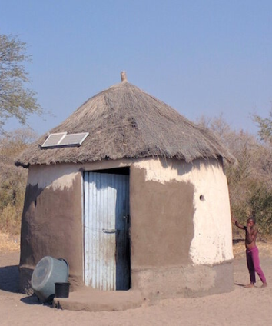
Case Study
VentureBuilder’s enterprise development
VentureBuilder (VB) is creating a new generation of African-owned and managed off-grid solar businesses that will deliver profitable, scalable, and sustainable modern electricity services to more than 2.4 million African households and enterprises. VB partners with seasoned local entrepreneurs who bring deep market knowledge and market traction on last mile distribution and/or off-grid solar.
In addition to equity, VB invests via enterprise development services (EDS), delivered by a team of seasoned industry experts that helps flatten the learning curve associated with off-grid solar business models. VB EDS investments centers on four pillars: corporate finance, strategy and governance, core operations, and consumer credit. VB helps build systems, processes, and capabilities around these pillars to create profitable off-grid solar businesses that offer a variety of products and services to meet household and enterprise needs.
Their partnership approach centers on skills transfer through mentoring and coaching, ensuring local knowledge is leveraged and further developed over time.
Image source: VentureBuilder
Notes:
C-Camp an Indian government partner tech incubator is integrating DRE across its existing portfolio for the first time (AJ).

Slide 34

Solutions to
close the skills gap:
Building capacity of productive end-users of DRE to maximise jobs and livelihoods potential
7.1 Energy access has huge potential to be a jobs multiplier in local and regional economies
Energy access has a livelihoods multiplier effect on local and regional economies: in addition to the direct jobs potential in the energy sector itself, up to 5 x more jobs could be created or enhanced through use of that energy, for example in powering agricultural livelihoods or small business activities (Shirley, 2020). The lack of the skills and knowledge to build businesses and integrate new appliances on the part of end-users is a significant barrier to realising the full livelihoods potential of the energy transition.
7.2 Supporting skills development for end-users is critical to unlock this potential
A lack of productive businesses using energy not only constrains livelihoods potential, but also the growth of DRE itself. In many energy poor regions, the costs of setting up and running distributed energy infrastructure outstrips the demand from end-users for that energy in the absence of productive applications. This gives little financial incentive to invest in or expand mini-grid and access. Supporting people to develop skills and access resources to run productive businesses is essential to making mini-grid access economically viable and should go hand-in hand with energy planning and roll-out (AL). In addition to skills, businesses need support with areas such as finance and access to markets (RK, AL).
7.3 Bridging the silos between the DRE, agriculture, and other, sectors
Energy programmes should connect with those already serving the livelihoods needs end-users at a local level. This might consist of agricultural or rural training centres, or larger entities. For example, EnerGrow in Uganda is rolling out productive micro business training, for users of DRE, in partnership with the extensive FAO farmer field school network (HJ, AL). This approach makes sure that the agricultural need is the starting point from which to design the energy intervention (REN).
7.4 Tackle systemic factors constraining the productive use of DRE in particular regions
Beyond the capacity of individual businesses, there are systemic factors holding farmers and small agri-businesses back in many parts of the world. These include unfair trade agreements and difficulty meeting export and import standards. In some regions, these can prevent farmers from adding value to raw materials in the first places or accessing key markets (RS). Though these challenges are beyond the scope of any individual DRE programme or enterprise to tackle, these constraints need to be accounted for in programmes design and discussed and changes advocated for at a policy level.

Slide 35
Case Studies
EnerGrow’s demand-side capacity building increasing electrification
Energy Change Lab creating productive use champions
EnerGrow is helping accelerate rural electrification in Uganda by helping energy companies improve demand and payments for electricity in rural areas. Energy companies partner with EnerGrow, who in turn provides their customers with micro-finance loans for productive use technologies as well as financial literacy and bookkeeping training, so they can afford and effectively use income generating electrical tools and equipment. The customer increases their income, EnerGrow makes a return on the loan, the energy company sells more electricity and the investor's risk is reduced.
EnerGrow is partnering with the Food and Agriculture Organisation (FAO) to scale up their demand-side capacity building efforts across Uganda. EnerGrow will support the FAO Farmer Field Schools programme by providing financing to farmer groups being trained at the schools, to help them deploy agro-processing hubs.
The Energy Change Lab in Tanzania was launched jointly by Hivos and the International Institute for Environment and Development (IIED) along with local partners, to run learning and leadership programmes for young people, entrepreneurs and energy professionals.
In 2017-18, ECL partnered with PowerCorner, a part of ENGIE, a mini-grid developer, and the Vocational Educational Training Authority to train community productive end-use champions to overcome the local skills gap. Capacity building methods included design of PUE training materials, educational videos, and equipment operating manuals in Swahili. Beyond training, ECL also worked on adjusting the enabling environment such as tariff reductions and accessing appliances to allow this network of PUE champions to thrive.

Slide 36
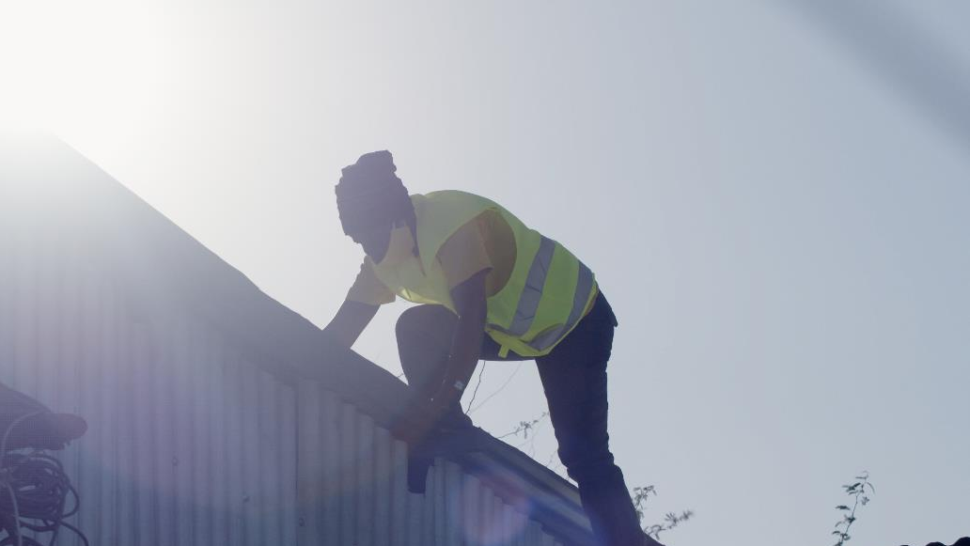
Grant funders have
a crucial role to play​

Slide 37
Recommendations
for grant funders
The ultimate vision for the sector is for there to be a skilled workforce delivering the clean energy transition globally by 2030, and for transformation in skills and jobs to catalyse a host of other social and environmental gains, including a more distributed and inclusive workforce, better jobs, empowerment for women and achievement of climate goals.
Because the development of skills for DRE is at a nascent stage, grant funders have an especially important role to play: they can take the necessary risk to get new innovation off the ground, seed new collaborations and move quickly to build data and understanding in this area.
There are a number of key areas to invest grant capital in, in order to unlock more financing and growth elsewhere. Support in these five areas will work together to shift the system towards the ultimate goal above.
1) Support governments to see the business case for investment in DRE skills and have access to cutting-edge policy advice. This will ensure DRE skills are prioritised globally and unlock the creation of policy frameworks that address key parts of the vision, such as dismantling barriers for marginalised groups, coordinating skills needs across sectors and supporting standardisation. This could include:
Funding initiatives that build the data underpinning investment in DRE skills, such as extending the Powering Jobs Census approach to other countries.
Supporting intermediaries to use this data to advocate for government prioritisation of DRE skills, to inform new policy and connect governments to other stakeholders.
2) Encourage increased funding from the philanthropic community, including grant funders, development agencies and impact investors, for DRE skills specifically. Awareness of the catalytic nature of investing in skills is low amongst grant funders, and there is still strong bias towards funding pure implementation projects. Grant funding is essential to de-risk future commercial investment in DRE skills and provide space for enterprises and institutions to innovate around new delivery models, materials and partnerships. Rallying this part of the finance sector will kickstart innovation and unlock commercial capital by taking on earlier-stage risk. This could include:
Advocating to peers in philanthropy for the need to invest in human capacity and supporting programmes to build the skills and knowledge of large donors themselves on where to invest capacity building budget effectively, and ways to identify the best local training providers.
Collaborate with other grant funders on at-scale programmes.

Slide 38
3) Invest in the building of partnerships across different parts of the ecosystem, particularly between industry, academia and government. Tackling the skills gap at scale will require innovative collaborations from parts of the sector that might not normally work together or be familiar with DRE, and relationship-forming work can be hard to fund. Grant funding can support the connective tissue between individual organisations that unlocks first-of-its kind curricula development, new collaborative programmes and the level of knowledge-sharing and standardisation necessary for joined-up and scaled-up training. This could look like:
Funding pioneering institutions and intermediaries to facilitate development, standardisation and sharing of training resources – building upon collaborative models such as the TEA-Learning Partnership, and pre-existing skill coalitions.
Seeding innovative collaborations between enterprises and educational institutes around mid-career development and informal sector outreach.
Supporting knowledge-sharing between enterprises on issues of capacity, through industry associations or enterprise collectives.
4) Bridge the funding gap in extending skills and training opportunities to the most marginalised and remote communities, ensuring that action on DRE skills is leading towards a just and inclusive energy transition. Philanthropy can play a leading role in going beyond the limitations of market forces alone and including those who would otherwise be left behind. Successful blended capital or cross-subsidisation models for DRE roll-out, such as the Beyond the Grid Fund for Zambia or that of the Togolese government, show that a grant component can unlock energy access and skills opportunities for the poorest, at scale as part of a wider commercial programme. Similarly, enterprises often rely on philanthropy to pilot beyond-business-as-usual approaches to building inclusive teams and serving the poorest customers: This could include:
Addressing the funding gap for low income and marginalised students to be included in educational and career development programmes, including outreach to the informal sector and initiatives that tackle barriers to women's involvement.
Supporting the upgrade and expansion of rural training infrastructure, curricula and programmes that empower established social organisations already embedded in communities.
Providing low-risk, flexible funding to help enterprises to innovate and pilot on skills and inclusivity. Ashden's Fair Cooling Fund (see Appendix A) provided a model for supporting innovation, follow-on funding and advocacy. The cohort innovation model supports innovators to stretch their ambition and learn from each other.
Recommendations
for grant funders

Slide 39
Recommendations
for grant funders
5) Create sufficient demand for DRE, and maximise livelihoods benefits, by building the skills and capacity of end-users to use sustainable energy productively. Though the need for skills development of micro and productive enterprises are widely recognised, scalable initiatives, integrated with DRE roll out, are nascent, and in need of catalytic philanthropy to test and scale them. This could include:
Funding the inclusion of productive-use focused capacity building components and programmes as part of the roll out of DRE, minigrids for example. Ensure this is provided alongside other livelihood-unlocking offerings, such as financing for equipment and support on access to markets.
Supporting intermediaries to convene stakeholders and develop programmes that bring the energy and agriculture sectors together (and other adjacent sectors).

Slide 40
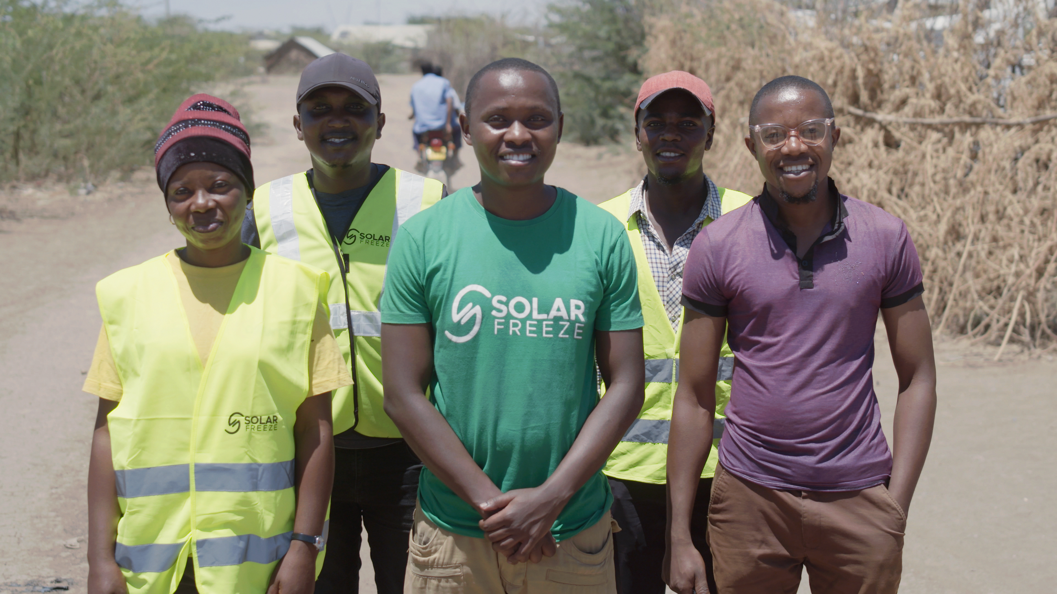
An Ashden Accelerator Cohort Programme could supercharge energy access

Slide 41
Next steps for Ashden:
The development of an accelerator cohort programme for jobs, skills and livelihoods in energy access
  We hope that this landscaping study provides a useful guide to any organisation considering making an intervention in skills for accelerating energy access. We will make it widely available.
  It is however, not a comprehensive study nor “complete”. This is a dynamic area which reflects the growing interest in skills for energy access. This is in large part due to the great work of IRENA, Power for All and SELCO Foundation, as well as the spotlight provided by the Ashden Award in Energy Access Skills in highlighting the desperate need for skilled people to populate jobs in the sector and make the most of the potential for livelihoods upgrade.
  Through the Awards, we know first-hand of innovative businesses and organisations across the energy access sector and in support of it, that hold some of the elements required to overcome the various barriers highlighted in this report. What we intend to do next is to look at how an accelerator programme will extend, scale and replicate the best of these emerging solutions. We refer to this intervention here as a “accelerator cohort programme” because we have seen that through facilitated collaboration brilliant ideas are more likely to fulfil their potential.
  We have successfully piloted this approach in relation to access to sustainable cooling [see Appendix A]. This was a small unrestricted grant investment fund of $600,000 in grassroots sustainable cooling solutions (the “Fair Cooling Fund”), designed to fund time and space for energy entrepreneurs to innovate in sustainable cooling solutions. Through careful collaboration around 7 concepts, we have facilitated new first time access to sustainable cooling for thousands of vulnerable people, whilst simultaneously elevating the issue of sustainable cooling as a development issue.
  In relation to energy access, we are developing an accelerator programme to:
    Unlock innovation and investment in skills as a means to create new green jobs and power livelihoods through skilled income-generating activities;
    Raise awareness of the need to focus on skills among donors and investors through powerful communications; and
    Highlight the need for cross-sector collaboration and knowledge-sharing.

Slide 42
Specific next
steps:
The development of an accelerator cohort programme for jobs, skills and livelihoods in energy access
  This work will continue beyond the life of this grant. We will organise a round of feedback from key stakeholders in this system. Starting with ECF.
  We will share the findings of this landscaping study with key stakeholders to:
    Test the robustness of the findings; and
    Develop the recommendations.
    In this way, we do not see this project as “finished”. It will be an ongoing inquiry to be added to, and developed as the number and quality of interventions in skills grow.
  As it stands, this study has confirmed to us:
    That innovation in skills for energy access has not received the attention and funding necessary for it to play the catalytic role in accelerating energy access.
    There are enterprises [that look like Ashden winners] that are attempting to bridge the gap between curriculum/formal education and work in the sector. And enterprises that work in/with productive uses also see a role for end-user training. In all cases, this may focus on gender issues and youth.
    There is innovation in how this training is being delivered, but collaboration and knowledge-sharing through a cohort programme of investment will accelerate this.
  The process of this landscaping has enabled us to talk to many stakeholders across the system. We are now in a position to concentrate our next conversations on developing partnerships to deliver an accelerator cohort programme.
  We will also work with Ashden Energy Access Skills awardees, runners-up and others to test their appetite to participate in a funded accelerator cohort programme and understand their needs.

Slide 43

Appendix A
Fair Cooling Fund
Summary
April 2020 – March 2022

Slide 44
Fair Cooling Fund
Closing Circle Invitation
'Cohort Model' for delivering
Ashden's
strategy
Impacts
Funding, support and communications
ecosystem that exists to widen access to cooling
We are fostering favourable enabling environments in which fair cooling initiatives can take root and grow
We are enabling organisations to grow their fair cooling activities and impact
We are increasing the flow of funding and resources into fair cooling initiatives
We are raising the prominence of fair cooling as a global development priority
Outcomes
Global outreach and engagement demonstrating the co-benefits of sustainable, socially-just cooling in practice, and its relevance for international sustainable development agendas
Activities
Charitable investing in sustainable, socially-just cooling initiatives and organisations' capacity to deliver them
Business support that enables organisations to accelerate the growth of their fair cooling initiatives
Collaborative development processes that open-up new perspectives and potential for impact

Slide 45
Launched 7 partner projects
Piloting a new model more suited to smaller, less resourced, farmers.
Ecofrost Mini manufacturing and market-testing in India – delivered by Ecozen on a commercial basis
PEG rural refrigeration – testing PAYG solar-powered freezers for productive use on a commercial basis in West Africa; going deep on understanding consumers
Assessing the feasibility and viability of micro-chilling hubs at village-level in India –delivered by Promethean Power Systems on a commercial basis for smaller, less resourced farmers
Project summaries
Retrofitting one self-built dwelling with passive cooling and other sustainability improvements, filming and disseminating the experience and implications to DIY home-builders – delivered by Mass Design in Rwanda, on a pre-commercial basis
Collaborating with universities to innovate and evaluate passive cooling technologies for self-built homes in India through women’s cooperatives – delivered by cBalance on a pre-commercial basis
Green Guidelines’ for government and private sector investment and design of rural housing development – by ECOnsult in Egypt, delivered on a pre-commercial basis
Research to document and replicate the ‘Urban Green Corridors’ of Medellin in Colombia – delivered by the Universidad de Pontificia Bolivariana (UPB) on a pre-commercial basis
Launched 1 Fair Cooling Fund
Developing a new co-delivery model enabling Ashden and its winners and runners-up to collaborate to pilot new initiatives and raise awareness of fair cooling as a development priority – delivered by Ashden on a not-for-profit basis.

Slide 46
3,470 people with new access to cooling in funding period
420,000 people with new access to cooling post 2023
Beyond expectations, 2 extra urban green corridors projects were confirmed and funded in Barranquilla and Sarajevo as a result of research and relationship-building
Headline impacts
The total funds raised/leveraged by the cohort and Ashden during the funding period is:
$6,060,567 (in large part due to UPB’s success)
One more fair cooling pilot project highly likely to be commissioned by the Government of Egypt
Ecozen has sold their newly developed mini freezer to the WFP
cBalance will be expanding to more Indian cities in 2022

Slide 47
External
Overheating homes undermine progress towards fundamental development goals
For example, in many countries women are more likely to work in their homes than men – so unbearable temperatures are an increasing threat to health, economic resilience and gender equality. This means governments, civil society organisations and funders can address multiple development priorities by taking on the cooling challenge. Demonstrating this caught the attention of the governments of Medellin, Barranquilla, and Sarajevo.
Tackle cooling alongside other challenges
As people most at risk from indoor heat stress face a wide range of urgent challenges, holistic initiatives that tackle cooling alongside other issues – from energy access to security and sanitation – have a greater chance of success. These are better placed to win backing from communities, but also investment from funders and authorities keen to address a range of priorities. Promethean won the backing of USAID as a result of their holistic approach, and cBalance won the backing of GIZ.
Community knowledge is essential
Attempts to tackle this problem in low-income communities are often top-down initiatives. But listening to, and working with, those in greatest danger is crucial. Only they can fully explain the mix of local factors, from poverty and overcrowding to insecure land tenure, that increase risk and undermine potential solutions. Success comes through co-developing solutions with communities (and allies, such as local NGOs), as well as drawing on traditional and indigenous knowledge. Ashden worked to embed the principles of fair cooling into the partners proposals and designs from the start, for fair cooling objectives to be realised. This included not only encouraging fair cooling principles to be included in the partner’s product design, but in some cases how they worked with their supply chain partners and customers.
Back skills and training for deep and long-lasting change
While helping communities access affordable and sustainable technology is essential, so is investment in skills and networks. This allows residents to create and maintain their own solutions, and even creates work opportunities within communities.
The role of ‘farmer-allied’ intermediaries (like Ecozen and Promethean) is important to facilitate access to rural cooling solutions, and associated markets and services
Sustainable intensification of smallholder farming has been highlighted by Project Drawdown as a key climate solution, as variable rainfall patterns reduce available arable land. Sustainable intensification means increasing yields while reducing demand to clear additional land. Promethean and Ecozen are contributing to this by reducing wastage and increasing the amount of consumable milk per cow or food per acre of land. Promethean and Ecozen are examples of two organisations who are working to support sustainable intensification by overcoming barriers to village-level chilling, such as the cost and size of technology, expensive diesel back-ups in weak grid areas and few options to sell produce once refrigerated. To counter these issues, Promethean and Ecozen developed smaller versions of their products, piloting business models that reduced the financial burden for the farmer in acquiring this technology and worked to accommodate smaller volumes of produce.
Internal
Developed Ashden’s cohort model
The Ashden cohort model consisted of three key components, funding, business support, and communications support. Co-development runs through all of these. We were pleased to be afforded the opportunity to develop and test this model in order to get proof of concept.
We have now built internal capacity to repeat the model, created a new process roadmap that can be adapted for future cohorts, and have created over 30 internal resources. We also carried out a comprehensive internal review that has unearthed learning and improvements we will apply to the next cycle.
Importance of evidenced based storytelling
Another important learning that we will carry through to the next cohort is that evidence-based story telling is a must, if we want to see this sector expand. Prototyping and piloting are one part of this project, the other is that we must be able to inspire others to believe not only in the business case of each product, but how each product can make a difference to a person’s life. We deliberately compiled a diverse cohort whose projects would collectively demonstrate the ways in which heat stress and access to sustainable cooling affects the lives and businesses of at-risk communities.
Lessons learned

